Slide 1

Stock Price Prediction
RNS INSTITUTE OF TECHNOLOGY
BENGALURU - 98
DEPARTMENT OF INFORMATION SCIENCE & ENGINEERING
Presentation on Internship
Candidate Name: ANANT DUBEY
USN: 1RN18IS017
Candidate Name: PRITHVI S
USN: 1RN18IS080
New Age Solutions Technologies
Internal Guide
Dr. Prakasha S & Mrs Sudha V Ramesh
Associate. Prof. , Assistant. Prof, Dept of ISE, RNSIT
External Guide
Mr. Deepak Garg
Founder, NASTECH, Bangalore

Slide 2
AGENDA
Abstract
About the Company
Introduction
Literature Survey
Requirements
System Design
Detailed Design
Implementation
Testing
Conclusion and Future Enhancements
References
Q & A

Slide 3
ABSTRACT
Machine learning has significant applications in the stock price prediction. In this machine learning project, we will be talking about predicting the returns on stocks. This is a very complex task and has uncertainties. We will develop this project into two parts:
First, we will learn how to predict stock price using the LSTM neural network.
Then we will build a dashboard using Plotly dash for stock analysis.

Slide 4
About the Company
NASTECH is formed with the purpose of bridging the gap between Academia and Industry.
NASTECH is one of the leading Global Certification and Training service providers for technical and management programs for educational institutions.
They collaborate with educational institutes to understand their requirements and form a strategy in consultation with all stakeholders to fulfill those by skilling, reskilling and upskilling the students and faculties on new age skills and technologies.

Slide 5
INTRODUCTION
Predicting how the stock market will perform is one of the most difficult things to do.
There are so many factors involved in the prediction – physical factors vs. psychological, rational and irrational behavior, etc. All these aspects combine to make share prices volatile and very difficult to predict with a high degree of accuracy.
Can we use machine learning as a game-changer in this domain? Using features like the latest announcements about an organization, their quarterly revenue results, etc., machine learning techniques have the potential to unearth patterns and insights we didn’t see before, and these can be used to make unerringly accurate predictions.

Slide 6
LITERATURE SURVEY
A day by day value of stock market prediction becomes an increasingly important issue in the present day.
There are various algorithms present in machine learning but some of them do not always yield accurate results. Therefore it is very important to develop the algorithms which is produced more accurate results.
Generally, traders used machine learning predictions to determine the factors that might be affect. The stock predictor produced large amount of data while analysis of dataset.
Each one of the machine learning algorithm has its own limitations and advantages over the other algorithms. out of the all machine learning algorithm linear regression has lot of advantages over other, The way linear regression algorithms work gives more accurate results with the least square methods.

Slide 7
Requirements
Hardware Requirements
- Processor: Pentium IV or above
- RAM: GB or more
- Hard Disk: 2GB or more
Software Requirements
- Operating System: Windows 7 /Linux
- IDE: Google Colab/ Jupiter Notebook
Tools/Languages/Platforms
- Python

Slide 8
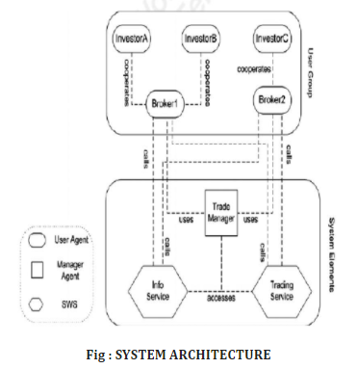
System Design
The mobile application is composed of two systems. The first is the mobile application which can used by the organization. Registration is a requirement when using the application.

Slide 9
Coding
Datasets
To build the stock price prediction model, we will use the NSE TATA GLOBAL dataset.
This is a dataset of Tata Beverages from Tata Global Beverages Limited, National Stock Exchange of India: Tata Global Dataset
To develop the dashboard for stock analysis we will use another stock dataset with multiple stocks like Apple, Microsoft, Facebook: Stocks Dataset

Slide 10
Implementation
1. Imports:
import pandas as pd
Import numpy as np
import matplotlib.pyplot as plt
%matplotlib inline
from matplotlib.pylab import rcParams
rcParams['figure.figsize']=20,10
from keras.models import Sequential
from keras.layers import LSTM,Dropout,Dense
from sklearn.preprocessing import MinMaxScaler

Slide 11
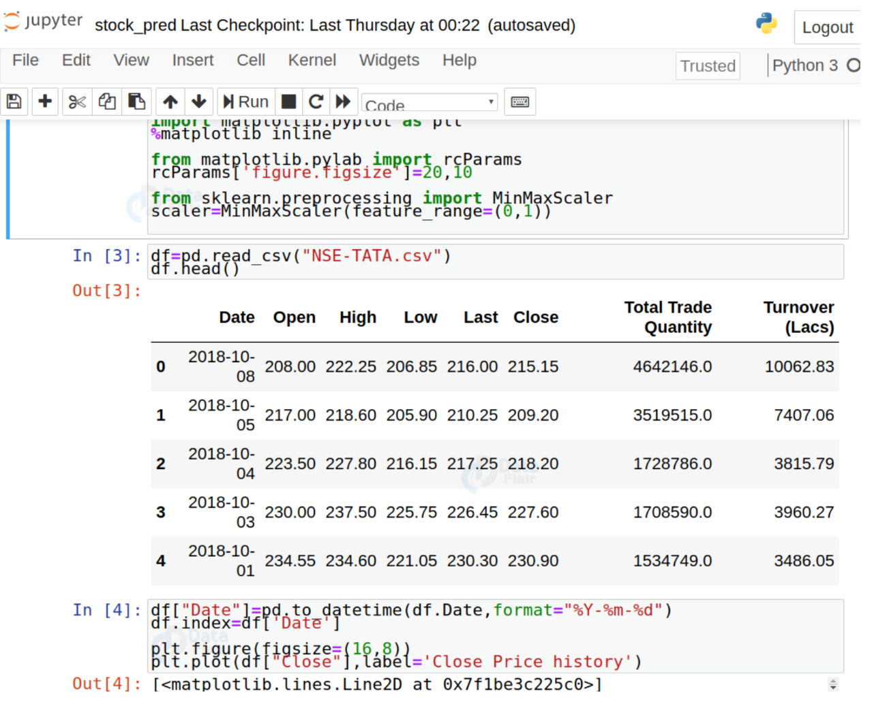
Implementation
2. Read the dataset:
We are reading the datasets used

Slide 12
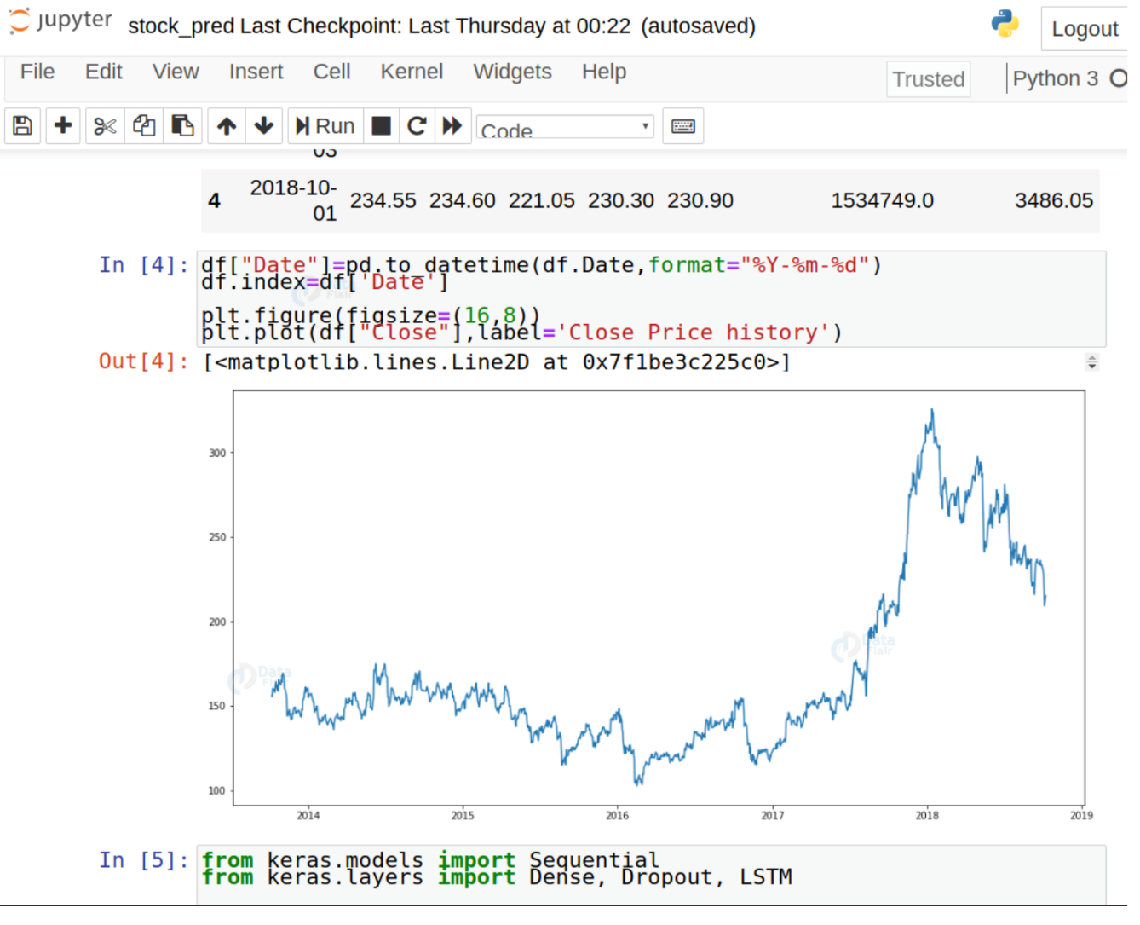
Implementation
3. Analyzing the closing prices from dataframe:

Slide 13
Implementation
4. Sort the dataset on date time and filter “Date” and “Close” columns
5. Normalize the new filtered dataset
6. Build and train the LSTM model
7. Take a sample of a dataset to make stock price predictions using the LSTM model
8. Save the LSTM model

Slide 14
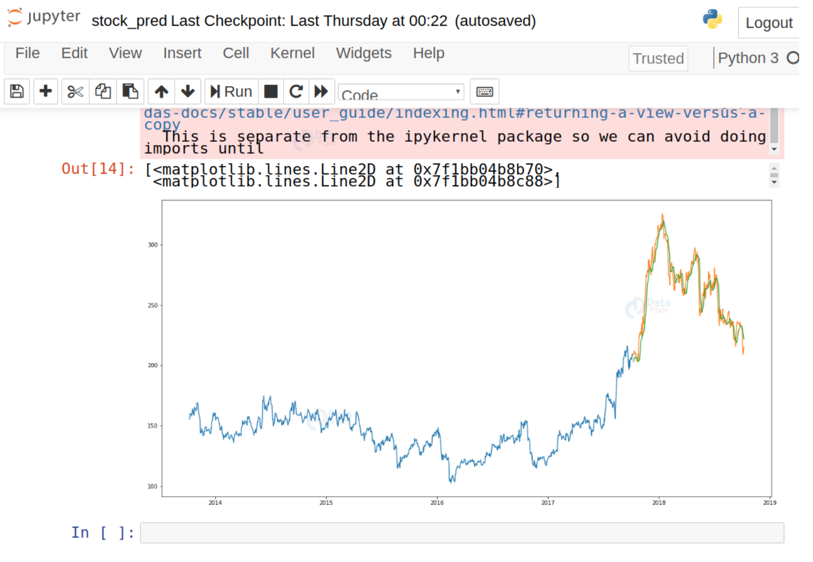
Implementation
Visualize the predicted stock costs with actual stock costs

Slide 15
Implementation
Next we Build the dashboard using Plotly dash
In this, we will build a dashboard to analyze stocks.
Dash is a python framework that provides an abstraction over flask and react.js to build analytical web applications.
Before moving ahead, you need to install dash. Run the below command in the terminal.

Slide 16
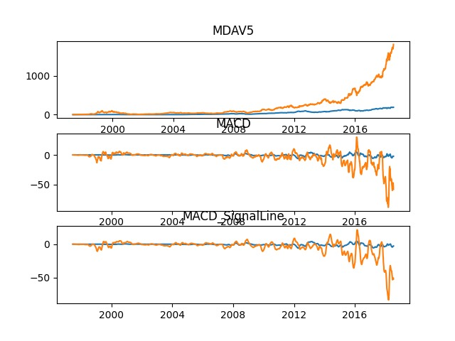
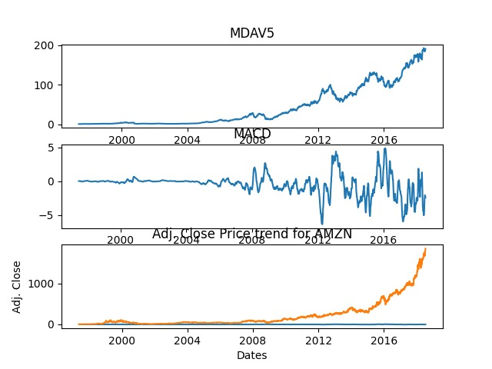
RESULTS
You can run the model on a list of symbols supplied as command line arguments.
python main.py [symbols]

Slide 17
Conclusion
Stock price prediction is a machine learning project.
In this we learned how to develop a stock cost prediction model and how to build an interactive dashboard for stock analysis.
We implemented stock market prediction using the LSTM model. OTOH, Plotly dash python framework for building dashboards.

Slide 18
Future Enhancements
As there is scope of improvement in each individual so is the case with this project. This project though predicts closing prices with very minimum Mean Squared Error, still there are many things that are lagging in this project. Two of most important things are :
There is no user interaction or interface provided in this project. A UI can be provided where user can check the value for future dates.
The stocks used for this project are only of Alphabet Inc, we can surely add more S&P 500 in the list so as to make this project more comprehensive.
I would definitely like to add these improvement to this project in future.

Slide 19
REFERENCES
[1]. Ashish Sharma, Dinesh Bhuriya, Upendra Singh. "Survey of Stock Market Prediction Using Machine
Learning Approach", ICECA 2017
[2]. Loke.K.S. “Impact Of Financial Ratios And Technical Analysis On Stock Price Prediction Using Random
Forests”, IEEE, 2017 .
[3]. Hakob GRIGORYAN, “A Stock Market Prediction Method Based on Support Vector Machines (SVM) and
Independent Component Analysis (ICA)”, DSJ 2016.
[4]. Huang1, Binxing Fang1, Philip Yu2, “Stock Market Prediction via Multi- Source Multiple Instance Learning.”
IEEE 2018 .
[5]. Vivek Kanade, Bhausaheb Devikar, Sayali Phadtare, Pranali Munde, Shubhangi Sonone. “Stock Market
Prediction: Using Historical Data Analysis”, IJARCSSE 2017.
[6]. Sachin Sampat Patil, Prof. Kailash Patidar, Asst. Prof. Megha Jain, “A Survey on Stock Market Prediction
Using SVM”, IJ CTET 2016 .

Slide 20
Question and Answer

Slide 21
THANK YOU

